Slide 1


Park Quality and the Relationship with Socioeconomic Demographics: A Joint DPR and CUSP Project

Slide 2
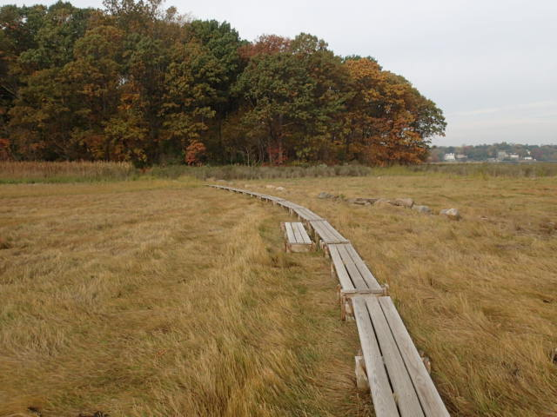
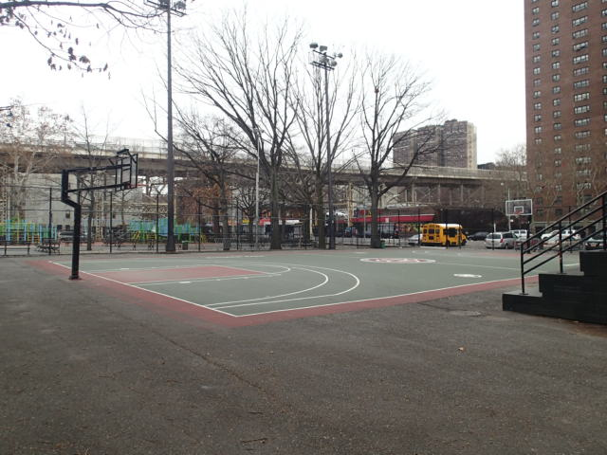
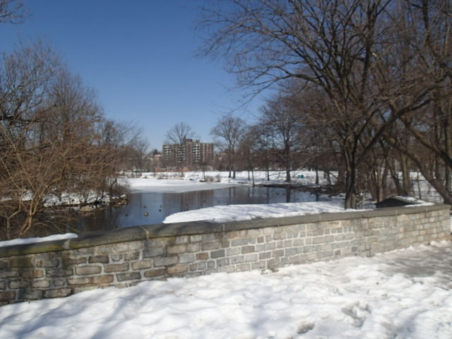
About NYC Parks:
NYC Parks is the City’s main provider of recreational and athletic programming, as well as the home of concerts, world-class sporting events, and cultural festivals. We conduct programming at various entities such as athletic fields, tennis courts, public pools, and recreation facilities. We also offer educational experiences at our historic house museums and monuments, as well as nature centers. We are the stewards of nearly 30,000 acres of land – 14 percent of New York City – with properties ranging from Coney Island Beach to Central Park to playgrounds and sitting areas. We also look after approximately 650,000 street trees and two million more in parks.

Slide 3
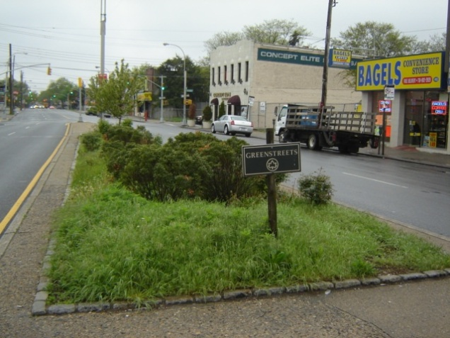
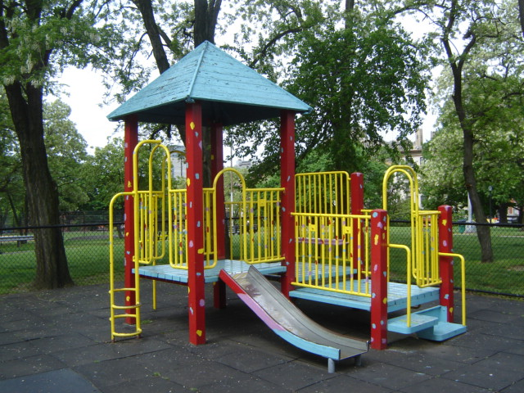
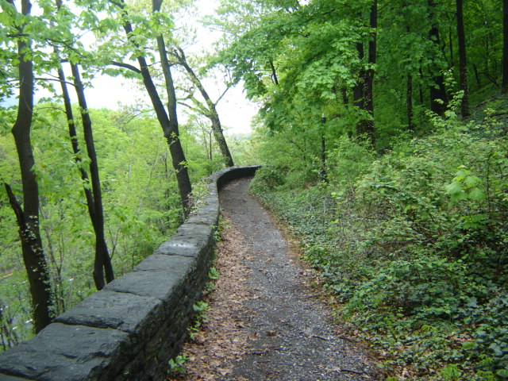
How we measure park quality:
NYC Parks has developed a comprehensive, outcome-based program to evaluate the conditions of city parks – the Parks Inspection Program (PIP). Through PIP, frequent, random, and detailed inspection reports of our parks and playgrounds are generated. The program has been designed to reflect current conditions encountered by the public when visiting city parks.
For inspection purposes, properties are divided into three broad categories: Small Parks such as playgrounds and sitting areas, Large Parks greater than six acres or sections (“zones”) of our flagship parks, and Greenstreets which are horticultural plantings at street intersections. 250 sites are randomly chosen for inspection every two weeks, based on the ratios of these property types in each borough.

Slide 4
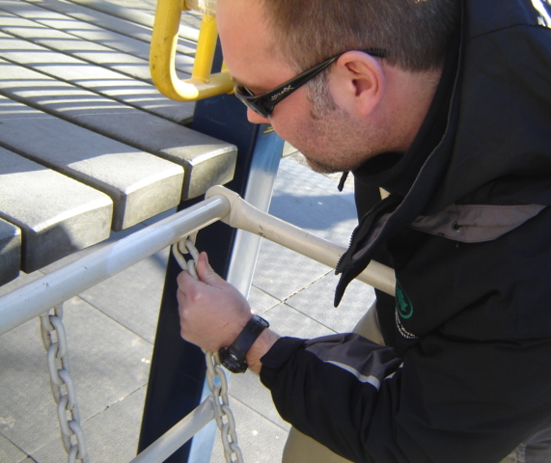
How we assign ratings:
Based on detailed standards and thresholds, PIP Inspectors assign a rating to four Cleanliness Features for every site, as well as any Landscape and Structural Features that are present. A typical playground might receive ratings for all six Structural Features below, as well the Landscape Features of Lawns and Trees. A Large Park might not have Play Equipment or Safety Surface, but may have Trails and Water Bodies. And a small Greenstreet might be composed primarily of a
Horticultural Area and Sidewalk. Ratings are assigned to a Feature in its totality, meaning all Fences or all Lawns or all Benches at the site are taken into account.
Cleanliness Features
glass
graffiti
ice
litter
weeds
Structural Features
benches
fences
paved surface
play equipment
safety surface
sidewalks
Landscape Features
athletic fields
horticultural areas
lawns
trails
trees
water bodies

Slide 5
How we compile the ratings:
Lastly, each site receives ratings for Overall Condition and Cleanliness based on the number or severity of failing features. These ratings are aggregated for the two-week inspection period by citywide, by park category, by borough, by district, and by individual feature. Along with our performance for the fiscal year to date, these ratings are presented at agency executive meetings and posted internally.
There are 24 two-week inspection “rounds” per year, six for each season. Here’s an example of the citywide ratings for the most recent inspection round, Spring 1:
 | Overall Condition |  |  |  |  | Cleanliness
 | Spring 1 |  | FY '15 (to date) | FY '14 (to date) | FY '13 (to date) | Spring 1 |  | FY '15 (to date) | FY '14 (to date) | FY '13 (to date)
Small Parks | 87% | +5% | 86% | 87% | 83% | 88% | +5% | 91% | 91% | 89%
Large Parks | 71% | +8% | 79% | 81% | 75% | 73% | +5% | 86% | 86% | 84%
Greenstreets | 96% | +1% | 97% | 97% | 95% | 96% | -1% | 98% | 98% | 98%
All Parks | 85% | +5% | 87% | 88% | 85% | 86% | +3% | 92% | 92% | 90%

Slide 6
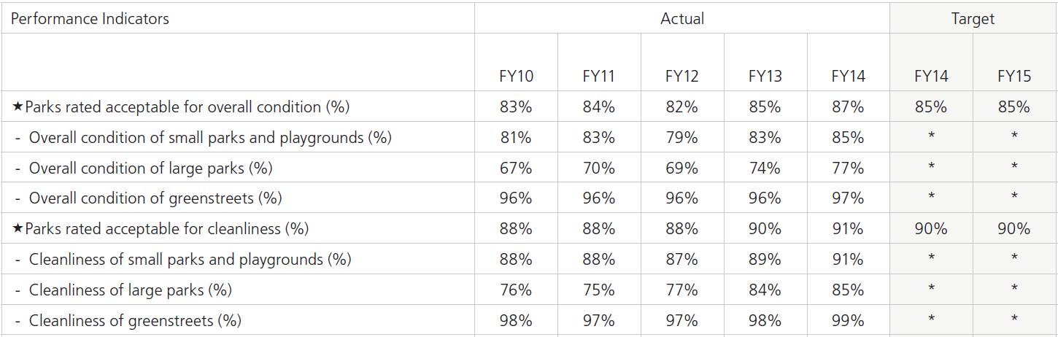
Current Performance:
Park ratings have been trending upward in recent years. According to the Fiscal 2014 Mayor’s Management Report (MMR), ratings for overall condition and cleanliness have been increasing and met performance targets the last two years.

Slide 7

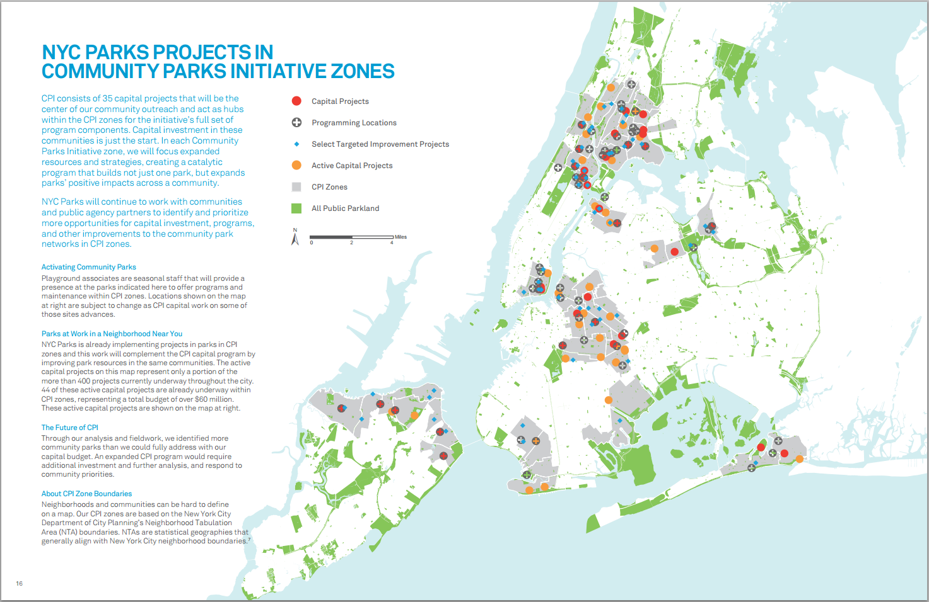
Park Equity:
Although park ratings have improved citywide in recent years, it has been theorized that park conditions are better in high income neighborhoods than low income neighborhoods. To address this perceived disparity, and in line with Mayor De Blasio’s call for park equity, the Agency implemented the Community Parks Initiative (CPI) to direct resources to possibly underserved parks.

Slide 8
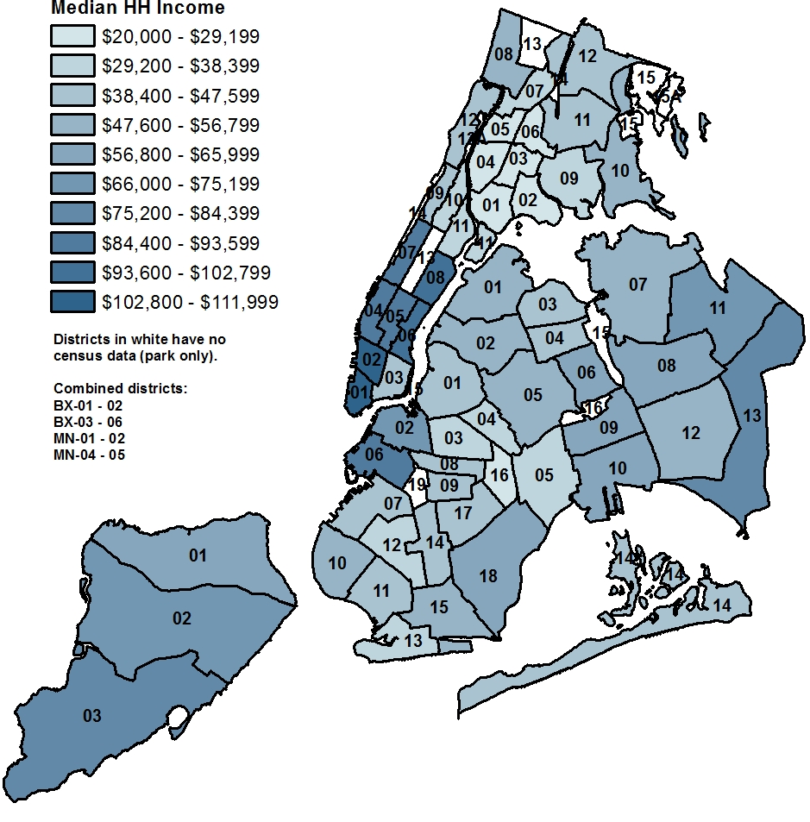
Concurrently with the CPI program, in spring 2014 the Operations and Management Planning division (OMP) conducted a study to determine if a strong relationship existed between community board (park district) economic demographics and overall park condition.
First, data from the 2000 U.S. Census and the 2010 - 2012 American Community Survey (ACS) were used to break down income by park district using Public Use Microdata Areas (PUMAs).

Slide 9
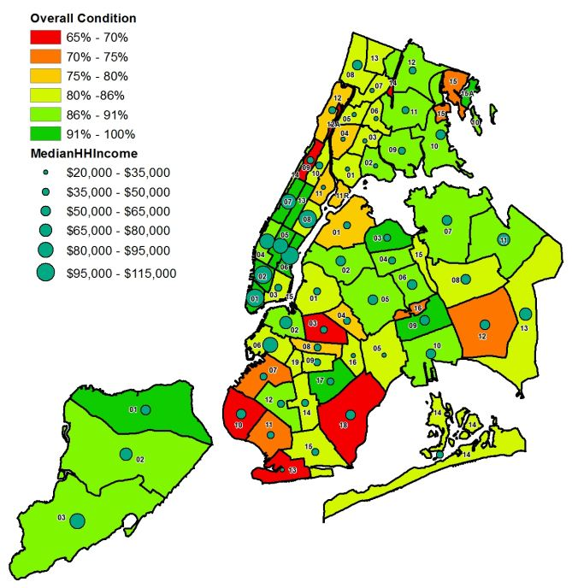
Next, park inspection results were aggregated and used to calculate park condition ratings by park district. This information was combined with the income data to produce maps to show a possible connection between the two factors.

Slide 10
Based on the initial study, the findings were found to be inconclusive.
Although the linear model shows a positive relationship between income and ratings, the r-squared was only .235, which indicates income by itself does not explain the variability in park quality that well.

Slide 11
Although the initial analysis was inconclusive, there are reasons why a more in-depth study is worthwhile – there is a discrepancy in park quality between park districts with above average income and below average income.
Overall Condition Four-year Period (CY 2010 - CY 2013)
 | BX | BK | MN | QN | SI | Citywide
Above | 86% | 81% | 93% | 86% | 89% | 86%
Below | 82% | 76% | 80% | 84% | 92% | 82%
 | 4% | 5% | 13% | 2% | -3% | 4%
Cleanliness Four-year Period (CY 2010 - CY 2013)
 | BX | BK | MN | QN | SI | Citywide
Above | 91% | 87% | 97% | 93% | 93% | 91%
Below | 86% | 82% | 87% | 89% | 96% | 87%
 | 5% | 5% | 10% | 4% | -3% | 4%

Slide 12
…and in some ways the discrepancy is growing, at least for cleanliness.

Slide 13
Next Steps:
So far, the NYC Parks analysis has focused mostly on the relationship between park quality and neighborhood income. As part of the enhanced analysis, NYC Parks would like to know how other variables factor in the differences in ratings. Other variables could be:
Neighborhood population and density
GIS-related property and inventory information
NYPD CompStat statistics
311 service request volume
Proximity to schools, clinics, and NYCHA housing
In summary, this is the main question to consider for this assignment:
What, if any, patterns emerge when comparing park ratings and features to the various neighborhoods and socioeconomic groups throughout the City?

Slide 14
Current list of datasets to be provided by DPR:
Parks Inspection Program (PIP) Datasets
All Sites
Inspection Main
Feature Inventory
Feature Ratings
Comfort Stations
Drinking Fountains
Park Visitors (based on scale)
Other Datasets
- Permits
GIS Datasets
Dog Run
Athletic Facility/Field
Functional Parkland
GreenThumb Garden
Park District
Parking Lot
Playground
Play Unit
Pool
Property
Safety Surface
Skate Park
Zone

